Slide 1
A-level Mathematics - 2 year Route Map
AS Maths year 1, A-level Maths year 2
(2017 specification)
This route map has been created to provide a suggested route for teaching the A-level Mathematics specification over 2 years. This route would allow a decision to be made about whether to enter students for the AS Mathematics at the end of year 1.
To activate the route map open it in PowerPoint, click on the Slide Show tab followed by the From Beginning button in the navigation bar. If you want to customise the route map (move topics around/change length of teaching time), please do so before running the slideshow. You can then save your customised version of the route map.
Clicking on a topic tile will then give further information about the specification references, specification notes and link to supporting resources.
Supporting resources for this teaching route will be available on All About Maths and will be added to the site in time for first teaching.
Please note this route map provides a suggested route to teaching the qualification, the topics can be taught in any order over any length of time to suit your own students.

Slide 2
Use of data in statistics
The Department for Education (DfE) have set out the following requirements regarding the use of data in statistics as follows:
9. AS and A level mathematics specifications must require students to:
become familiar with one or more specific large data set(s) in advance of the final assessment (these data must be real and sufficiently rich to enable the concepts and skills of data presentation and interpretation in the specification to be explored)
use technology such as spreadsheets or specialist statistical packages to explore the data set(s)
interpret real data presented in summary or graphical form
use data to investigate questions arising in real contexts
10. Specifications should require students to explore the data set(s), and associated contexts, during their course of study to enable them to perform tasks that assume familiarity with the contexts, the main features of the data and the ways in which technology can help explore the data. Specifications should also require students to demonstrate the ability to analyse a subset or features of the data using a calculator with standard statistical functions, as detailed in paragraph 8 (please see DfE content for further information).
We encourage the use of statistical data sets and statistical packages throughout the course of study of statistics. In this route map, we have set aside 2 weeks in year 12, weeks 41 and 42, to encourage independent interrogation of data. In week 41, we suggest students study an A-level statistics topic and in week 42, we suggest students complete an activity using statistical packages. Note: It is up teachers to decide which statistics topics to use with statistical data sets and packages. The weeks suggested and the content suggested (N2 and N3) are an example.

Slide 3
A-level Mathematics - 2 year Route Map, - AS Maths year 1, A-level Maths year 2
(2017 specification)
Algebra & Proof
Geometry
Calculus
Trigonometry
Exponentials & Logarithms
Sequences & Series
Numerical
Methods
Statistics
Mechanics
Year 12

Slide 4
A-level Year 1(new spec) – September 2018 (Mon 6&7, Tue 3&4, Wed 1&2)
3-7 Sept | 10-14 Sept | 17-21 Sept | 24-28 Sept | 1-5 Oct | 8-12 Oct | 15-19 Oct | 22 – 26 Oct Holiday
29 – 2 Nov | 5 – 9 Nov | 12-16 Nov | 19-23 Nov | 26-30 Nov | 3-7 Dec | 10-14 Dec | 17-21 Dec
24-4 Jan Holiday | 7-11 Jan | 14-18 Jan | 21-25 Jan | 28-1 Feb | 4-8 Feb | 11-15 Feb | 18-22 Feb Holiday
25-1 Mar | 4-8 Mar | 11-15 Mar | 18-22 Mar | 25-29 Mar | 1-5 Apr | 8-12 Apr Holiday | 15-19 Apr Holiday
22-26 Apr | 29-3 May | 6-10 May | 13-17 May | 20-24 May | 27-31 May Holiday | 3-7 June | 10-14 June
17-21 June | 24-28 June | 1-5 July | 8-12 July | 15-19 July | 22-26 July Holiday | 29-2 Aug July Holiday | 5-9 August Holiday
C1-C2 Straight Lines & Circles 1.6 (8)
B5, B7, B9 Graphs, Linear & Quadratic Inequalities 1.7, 2.4 (12)
B1-B4 Algebraic Manipulation 1.2 – 1.5 (7)
B6 Polynomials 2.1, 2.3 (5)
D1 Binomial Expansions 2.2 (5)
A1 Proof 1.1 (4)
K1 Statistical Sampling (4) 9.1
F1, F4, F5 Logarithms 5.1 (6)
B5, B7, B9 Graphs, Linear & Quadratic Inequalities 1.7, 2.4 (12)
J1-J4 Vectors 6.1- 6.2 (12)
D1 Binomial
E1, E3, E5, E7 Trigonometry 3.1 (9), E1 Sine ad Cosine rules 3.2 (3)
G1-G3 Differentiation 4.1 - 4.5 (15)
L1-4 Data Presentation & Interpretation (8) 9.2-9.4
M1 N1 Probability & Statistical Distributions (9) 10.1 – 10.2
J1-J4 Vectors 6.1- 6.2 (12)
Exam Week
J1-J4 Vectors 6.1- 6.2 (12)
P1 Q1 – Q4 Kinematics in one Dimension7.1 – 7.4 (15)
G1-G3 Differentiation 4.1 - 4.5 (15)
G1-G3 Differentiation 4.1 - 4.5 (15)
M1 N1
F1 – F3, F6, F7 Exponentials & Logarithms 5.2 – 5.4 (12)
P1 Q1 – Q4 Kinematics in one Dimension7.1 – 7.4 (15)
R1 – R4 Forces & Newton’s Laws 8.1 – 8.4 (15)
G1-G3 Differentiation 4.1 - 4.5 (15)
H1-H3 Integration 4.6, 4.7 (12)
F1 – F3, F6, F7 Exponentials & Logarithms 5.2 – 5.4 (12)
01 Statistical Hypothesis Testing (9) 11.1 – 11.2
R1 – R4 Forces & Newton’s Laws 8.1 – 8.4 (15)
R1 – R4 Forces & Newton’s Laws 8.1 – 8.4 (15)
R1 – R4 Forces & Newton’s Laws 8.1 – 8.4 (15)
Exam Week
H1-H3 Integration 4.6, 4.7 (12)
(Y2 MODULE)J1, J5, Q3-Q5 Kinematics in two dimensions
(18.1,18.3-18.4)
Consolidation
Consolidation
01 Statistical Hypothesis Testing (9) 11.1 – 11.2
N2 – N3 Statistical Distributions
Analysis of Data using Statistical Packages
R1 – R4 Forces & Newton’s Laws 8.1 – 8.4 (15)
R1 – R4 Forces & Newton’s Laws 8.1 – 8.4 (15)
Consolidation
Notes:
EVERYTHING!!
Except dates
Done before sept: chapter1 (5), 2 (4), 4 (6) (lessons) 1 lesson calculator skills
4

Slide 5
Year 12 (new spec) – September 2017 (Mon 3+4, Tues 6+7, Thurs 1+2)
4 – 8 Sept | 11 – 15 Sept | 18 – 22 Sept | 25 – 29 Sept | 2 – 6 Oct | 9 – 13 Oct | 16 – 20 Oct | 23 – 27 Oct Holiday
30 – 3 Nov | 6 – 10 Nov | 13 – 17 Nov | 20 – 24 Nov | 27 – 1 Dec | 4 – 8 Dec | 11 – 15 Dec | 18 – 19 Dec
25 - 29 Dec Holiday | Wed 3 - 5 Jan | 8- 12 Jan | 15 – 19 Jan | 22 – 26 Jan | 29 - 2 Feb | 5 - 9 Feb | 12 – 16 Feb Holiday
19 - 23 Feb | 26 - 2 Mar | 5 - 9 Mar | 12 - 16 Mar | 19 - 23 Mar | 26 - 30 Mar | 2 – 6 Apr Holiday | 9 - 13 Apr Holiday
16 - 20 Apr | 23 – 27 Apr | 30 - 4 May | 7 - 11 May | 14 - 18 May | 21 - 25 May | 28 - 1 June Holiday | 4 - 8 June
11 - 15 June | 18 - 22 June | 25 – 29 June AW | 2 – 6 July | 9 – 13 July | 16 – 20 July
B1-B4 Algebraic Manipulation
1.2 – 1.5 (7)
A1 Proof 1.1 (4)
B6 Polynomials
2.1, 2.3 (5)
D1 Binomial Expansions 2.2 (5)
C1-C2 Straight Lines & Circles 1.6 (8)
J1-J4 Vectors 6.1- 6.2 (12)
D1 Binomial Expansions 2.2
E1, E3, E5, E7 Trigonometry 3.1 (9), E1 Sine ad Cosine rules 3.2 (3)
F1, F4, F5 Logarithms 5.1 (6)
J1-J4 Vectors 6.1- 6.2 (12)
B5, B7, B9 Graphs, Linear & Quadratic Inequalities 1.7, 2.4 (12)
G1-G3 Differentiation 4.1 - 4.5 (15)
Exam Week
K1 Statistical Sampling (4) 9.1
L1-4 Data Presentation & Interpretation (8) 9.2-9.4
G1-G3 Differentiation 4.1 - 4.5 (15)
G1-G3 Differentiation 4.1 - 4.5 (15)
Consolidation Week
F1 – F3, F6, F7 Exponentials & Logarithms 5.2 – 5.4 (12)
M1 N1 Probability & Statistical Distributions (9) 10.1 – 10.2
H1-H3 Integration 4.6, 4.7 (12)
P1 Q1 – Q4 Kinematics in one Dimension7.1 – 7.4 (15)
Consolidation Starters
M1 N1 Probability & Stat Distributi
01 Statistical Hypothesis Testing (9) 11.1 – 11.2
N2 – N3 Statistical Distributions
Analysis of Data using Statistical Packages
P1 Q1 – Q4 Kinematics in one Dimension7.1 – 7.4 (15)
R1 – R4 Forces & Newton’s Laws 8.1 – 8.4 (15)
R1 – R4 Forces & Newton’s Laws
Consolidation Starters
Consolidation Starters
Exam Week
Analysis of Data using Statistical Packages
R1 – R4 Forces & Newton’s Laws
Consolidation Starters
Notes:
EVERYTHING!!
Except dates
Done before sept: chapter1 (5), 2 (4), 4 (6) (lessons) 1 lesson calculator skills

Slide 6
A-level Mathematics - 2 year Route Map, - AS Maths year 1, A-level Maths year 2
(2017 specification)
Year 12
Algebraic Manipulation, Quadratic Equations & Simultaneous Equations
Algebraic Manipulation, Quadratic Equations & Simultaneous Equations
Graphs, Linear & Quadratic Inequalities
Straight Lines & Circles
Binomial Expansions
Differentiation
Holiday
Differentiation
Integration
Integration
Trigonometry
Mock Examinations
and Revision
Mock Examinations
and Revision
Holiday
Holiday
Vectors
Proof
Exponentials & Logarithms
Holiday
Statistical Sampling
Data Presentation & Interpretation
Probability & Statistical Distributions
Statistical
Hypothesis Testing
Holiday
Holiday
Kinematics in One Dimension
Forces & Newton’s Laws
Summer
Examinations
and Revision
Summer
Examinations
and Revision
Holiday
Summer
Examinations
and Revision
Summer
Examinations
and Revision
Statistical Distributions
Analysis of Data using Statistical Packages
Year 13

Slide 7
A-level Mathematics - 2 year Route Map, - AS Maths year 1, A-level Maths year 2
(2017 specification)
Year 13
Binomial Theorem, Sequences & Series
Trigonometry & Circular Measure
Functions & Transformations
Further Differentiation
Holiday
Further
Integration
Numerical Methods
Parametric Equations
Mock Examinations
and Revision
Mock Examinations
and Revision
Holiday
Holiday
Trigonometry
Partial Fractions & Integration
Differential Equations
Holiday
Kinematics in Two Dimensions
Equilibrium & Resolving
Statics & Dynamics
Moments
Holiday
Holiday
Further
Probability
Statistical Distributions
Statistical Hypothesis Testing
Revision
Summer
Examinations
and Revision
Summer
Examinations
and Revision
Holiday
Summer
Examinations
and Revision
Summer
Examinations
and Revision
Summer
Examinations
and Revision
Summer
Examinations
and Revision
Year 12

Slide 8
Year 12

Slide 9
Algebraic Manipulation, Quadratic Equations
and Simultaneous Equations (slide 1 of 2)
Continued on next page
 | Specification content: | Specification notes:
B1 | [Understand and use the laws of indices for all rational exponents] | Chapter 1.2
B2 | [Use and manipulate surds, including rationalising the denominator] | Chapter 1.3
B3 | [Work with quadratic functions and their graphs; the discriminant of a quadratic function, including the conditions for real and repeated roots; completing the square; solution of quadratic equations including solving quadratic equations in a function of the unknown] | Chapter 1.4

Slide 10
Algebraic Manipulation, Quadratic Equations
and Simultaneous Equations (slide 2 of 2)
 | Specification content: | Specification notes:
B4 | [Solve simultaneous equations in two variables by elimination and by substitution, including one linear and one quadratic equation] | Chapter 1.5
B6 | [Manipulate polynomials algebraically, including expanding brackets and collecting like terms, factorisation and simple algebraic division; use of the factor theorem] | Chapter 2.1 and 2.3 Assumed knowledge: simplifying and manipulating algebraic expressions Simplifying rational expressions will be covered in year 13, Functions & Transformations

Slide 11
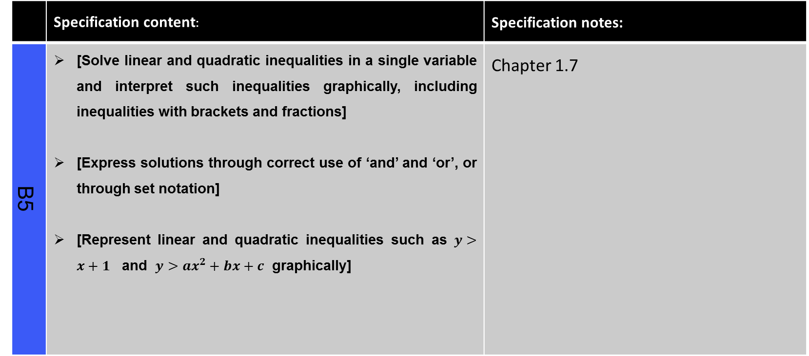
Continued on next page
Graphs, Linear & Quadratic Inequalities (slide 1 of 3)
 | Specification content: | Specification notes:
B5 | [Solve linear and quadratic inequalities in a single variable and interpret such inequalities graphically, including inequalities with brackets and fractions] [Express solutions through correct use of ‘and’ and ‘or’, or through set notation] [Represent linear and quadratic inequalities such as $y>x+1$ and $y>ax^{2}+bx+c$ graphically] | Chapter 1.7

Slide 12
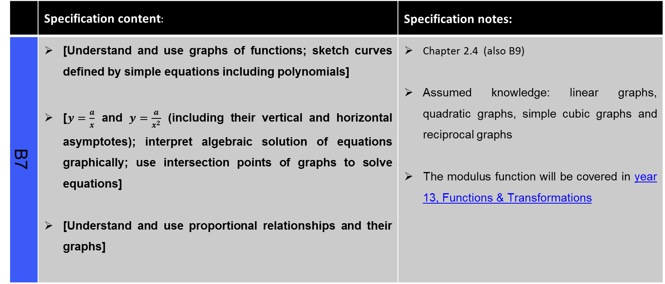
Continued on next page
Graphs, Linear & Quadratic Inequalities (slide 2 of 3)
 | Specification content: | Specification notes:
B7 | [Understand and use graphs of functions; sketch curves defined by simple equations including polynomials] [$y=\frac{a}{x}$ and $y=\frac{a}{x^{2}}$ (including their vertical and horizontal asymptotes); interpret algebraic solution of equations graphically; use intersection points of graphs to solve equations] [Understand and use proportional relationships and their graphs] | Chapter 2.4 (also B9) Assumed knowledge: linear graphs, quadratic graphs, simple cubic graphs and reciprocal graphs The modulus function will be covered in year 13, Functions & Transformations

Slide 13
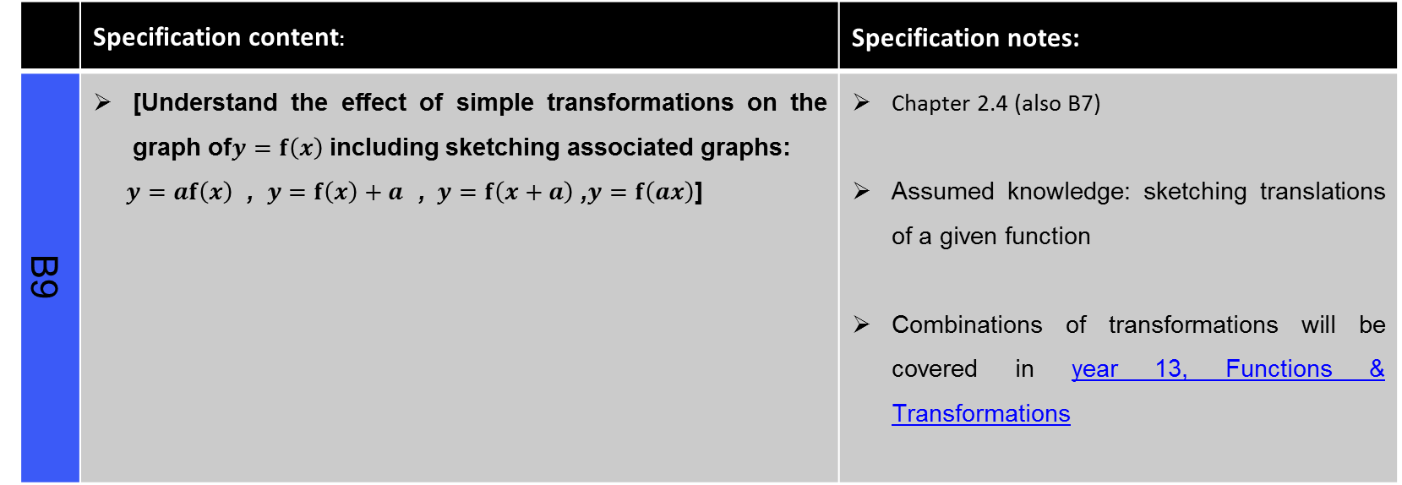
Graphs, Linear & Quadratic Inequalities (slide 3 of 3)
 | Specification content: | Specification notes:
B9 | [Understand the effect of simple transformations on the graph of$y=f\left(x\right)$ including sketching associated graphs: $y=af\left(x\right)$ , $y=f\left(x\right)+a$ , $y=f\left(x+a\right)$ ,$y=f\left(ax\right)$] | Chapter 2.4 (also B7) Assumed knowledge: sketching translations of a given function Combinations of transformations will be covered in year 13, Functions & Transformations

Slide 14
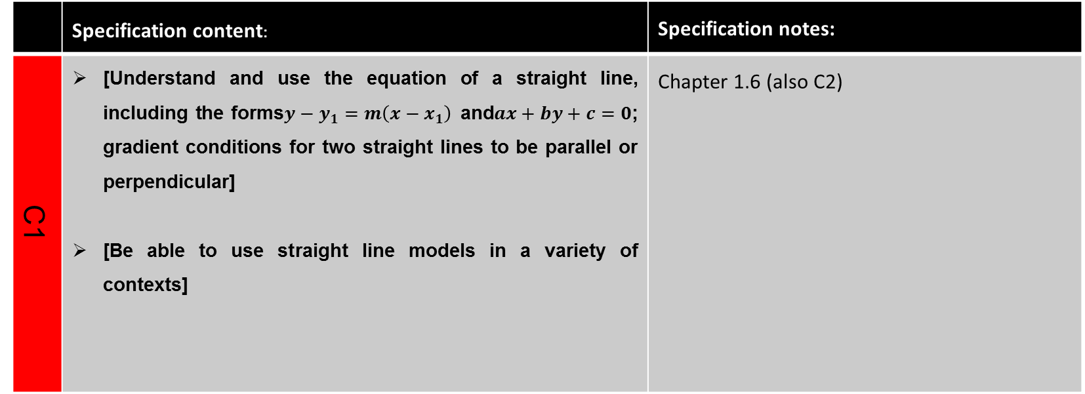
Continued on next page
Straight Lines & Circles (slides 1 of 2)
 | Specification content: | Specification notes:
C1 | [Understand and use the equation of a straight line, including the forms$y−y_{1}=m\left(x−x_{1}\right)$and$ax+by+c=0$; gradient conditions for two straight lines to be parallel or perpendicular] [Be able to use straight line models in a variety of contexts] | Chapter 1.6 (also C2)

Slide 15
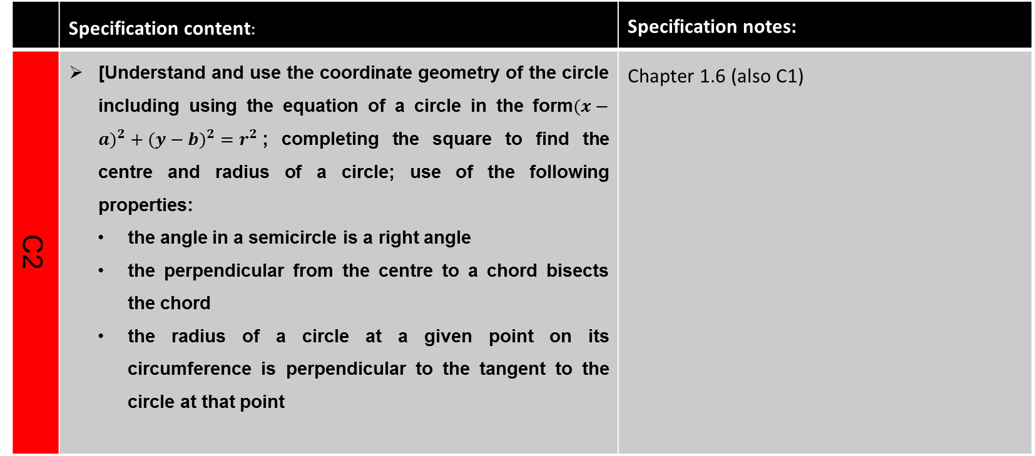
Straight Lines & Circles (slide 2 of 2)
 | Specification content: | Specification notes:
C2 | [Understand and use the coordinate geometry of the circle including using the equation of a circle in the form$(x−{a)}^{2}+(y−{b)}^{2}=r^{2}$; completing the square to find the centre and radius of a circle; use of the following properties: the angle in a semicircle is a right angle the perpendicular from the centre to a chord bisects the chord the radius of a circle at a given point on its circumference is perpendicular to the tangent to the circle at that point | Chapter 1.6 (also C1)

Slide 16
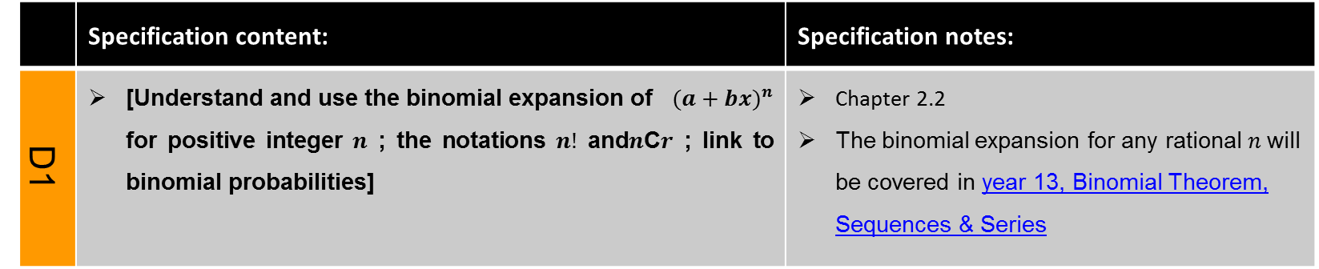
Binomial Expansions
 | Specification content: | Specification notes:
D1 | [Understand and use the binomial expansion of $(a+b{x)}^{n}$ for positive integer $n$ ; the notations $n!$ and$n$C$r$ ; link to binomial probabilities] | Chapter 2.2 The binomial expansion for any rational $n$will be covered in year 13, Binomial Theorem, Sequences & Series

Slide 17
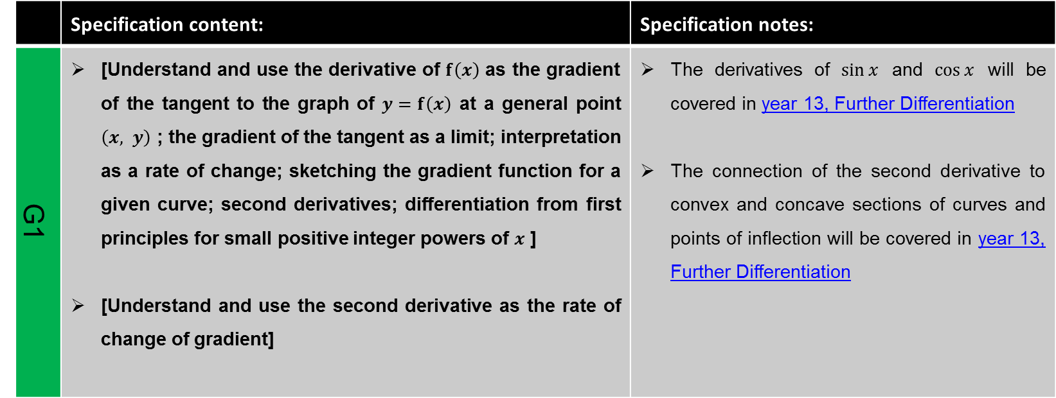
Continued on next page
Differentiation (slide 1 of 2)
 | Specification content: | Specification notes:
G1 |  | Chapter 4.1

Slide 18
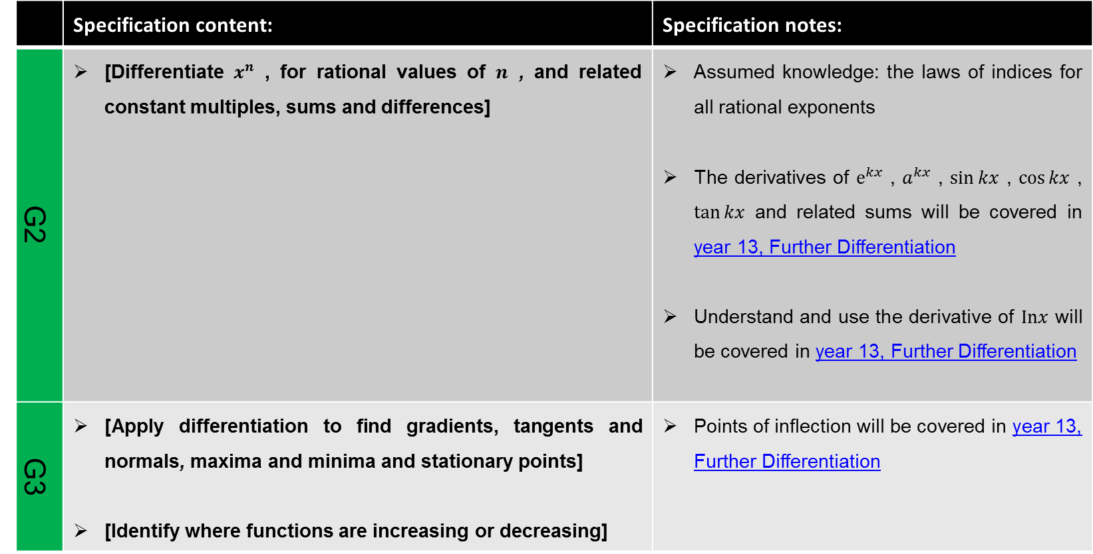
Differentiation (slide 2 of 2)
 | Specification content: | Specification notes:
G2 |  | Chapter 4.2
G3 | [Apply differentiation to find gradients, tangents and normals, maxima and minima and stationary points] [Identifywhere functions are increasing or decreasing] | Points of inflection will be covered in year 13, Further Differentiation Chapter 4.4

Slide 19
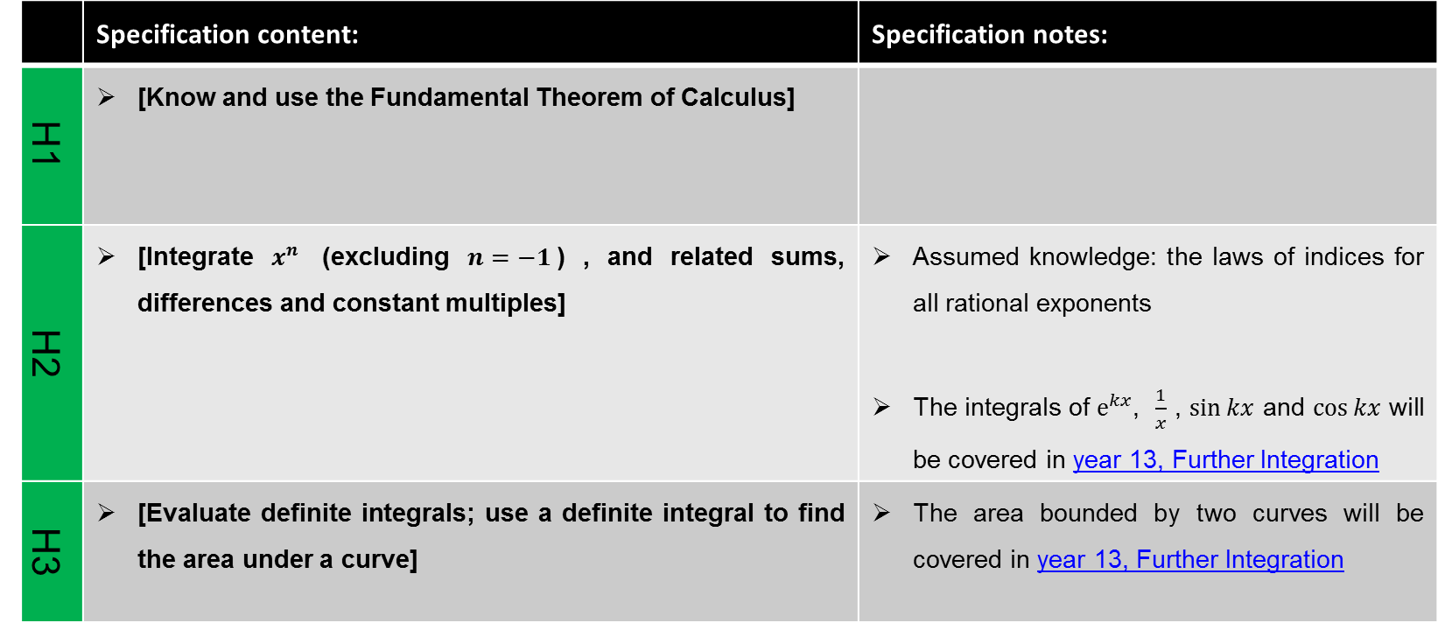
Integration
 | Specification content: | Specification notes:
H1 | [Know and use the Fundamental Theorem of Calculus] | Chapter 4.6 (and H2)
H2
H3 | [Evaluate definite integrals; use a definite integral to find the area under a curve] | The area bounded by two curves will be covered in year 13, Further Integration Chapter 4.7

Slide 20
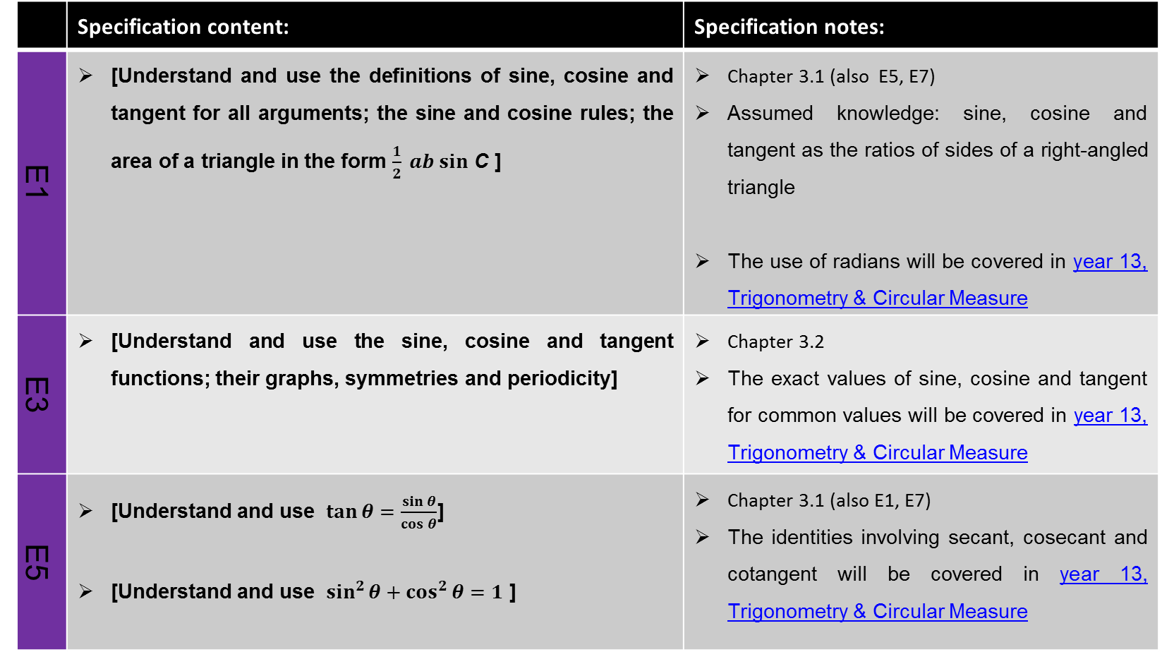
Continued on next page
Continued on next page
Trigonometry (slide 1 of 2)
 | Specification content: | Specification notes:
E1 | [Understand and use the definitions of sine, cosine and tangent for all arguments; the sine and cosine rules; the area of a triangle in the form $\frac{1}{2} ab sin$ C ] | Chapter 3.1 (also E5, E7) Assumed knowledge: sine, cosine and tangent as the ratios of sides of a right-angled triangle The use of radians will be covered in year 13, Trigonometry & Circular Measure
E3 | [Understand and use the sine, cosine and tangent functions; their graphs, symmetries and periodicity] | Chapter 3.2 The exact values of sine, cosine and tangent for common values will be covered in year 13, Trigonometry & Circular Measure
E5 | [Understand and use $\tan{θ}=\frac{\sin{θ}}{\cos{θ}}$] [Understand and use $\sin^{2}{θ+\cos^{2}{θ=1}}$ ] | Chapter 3.1 (also E1, E7) The identities involving secant, cosecant and cotangent will be covered in year 13, Trigonometry & Circular Measure

Slide 21
Continued on next page
Trigonometry (slide 2 of 2)
 | Specification content: | Specification notes:
E7 | [Solve simple trigonometric equations in a given interval, including quadratic equations in sin, cos and tan and equations involving multiples of the unknown angle] | Chapter 3.1 (also E1, E5)

Slide 22
Continued on next page
Vectors (slide 1 of 2)
 | Specification content: | Specification notes:
J1 | [Use vectors in two dimensions] | Chapter 6.1 Vectors in three dimensions will be covered in year 13, Kinematics in Two Dimensions
J2 | [Calculate the magnitude and direction of a vector and convert between component form and magnitude/direction form] | Chapter 6.2
J3 | [Add vectors diagrammatically and perform the algebraic operations of vector addition and multiplication by scalars, and understand their geometrical interpretations] | Chapter 6.2
J4 | [Understand and use position vectors; calculate the distance between two points represented by position vectors] | Chapter 6.2

Slide 23
Vectors (slides 2 of 2)
 | Specification content: | Specification notes:
J5 | [Use vectors to solve problems in pure mathematics and in context, including forces] | Chapter 8.1 The use of vectors in kinematics problems will be covered in year 13, Kinematics in Two Dimensions

Slide 24
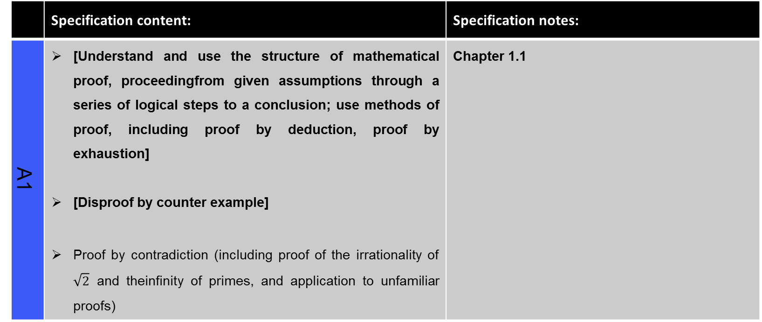
Proof
 | Specification content: | Specification notes:
A1 | [Understand and use the structure of mathematical proof, proceedingfrom given assumptions through a series of logical steps to a conclusion; use methods of proof, including proof by deduction, proof by exhaustion] [Disproof by counter example] Proof by contradiction (including proof of the irrationality of $\sqrt{2}$ and theinfinity of primes, and application to unfamiliar proofs) | Chapter 1.1

Slide 25
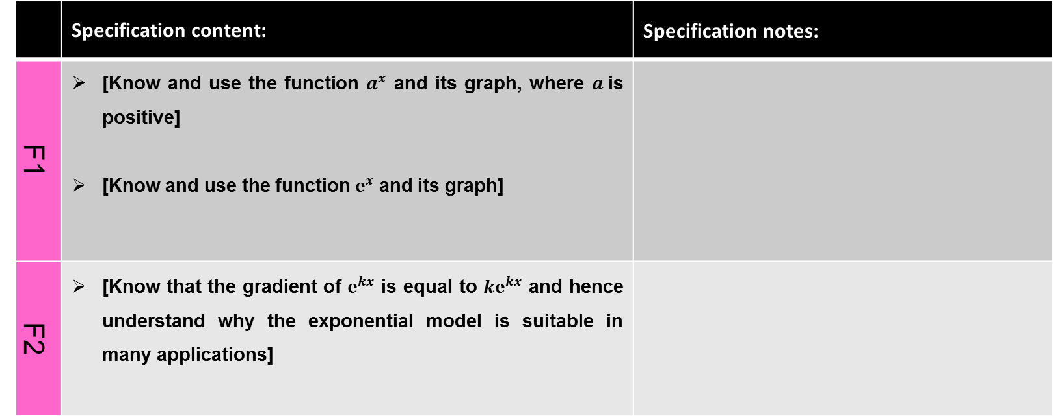
Continued on next page
Exponentials & Logarithms (slides 1 of 3)
 | Specification content: | Specification notes:
F1 | [Know and use the function $a^{x}$and its graph, where $a$is positive] [Know and use the function $e^{x}$ and its graph]
F2 | [Know that the gradient of $e^{kx}$is equal to ${ke}^{kx}$ and hence understand why the exponential model is suitable in many applications]

Slide 26
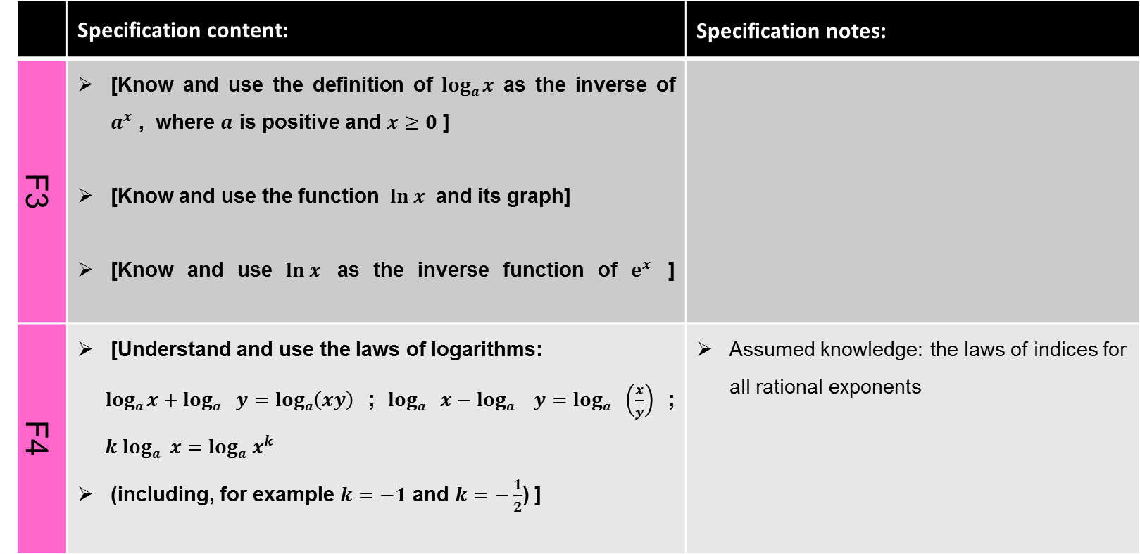
Continued on next page
Exponentials & Logarithms (slides 2 of 3)
 | Specification content: | Specification notes:
F3 | [Know and use the definition of $loga x$ as the inverse of $a^{x}$ , where $a$ispositive and $x≥0$ ] [Know and use the function $\ln{x}$ and its graph] [Know and use $\ln{x}$ as the inverse function of $e^{x}$ ]
F4 | [Understand and use the laws of logarithms: $loga x+logay=loga\left(xy\right)$ ; $logax−loga y=loga\left(\frac{x}{y}\right)$ ; $k loga x=logax^{k}$ (including, for example $k=−1$ and $k=−\frac{1}{2}$) ] | Assumed knowledge: the laws of indices for all rational exponents

Slide 27
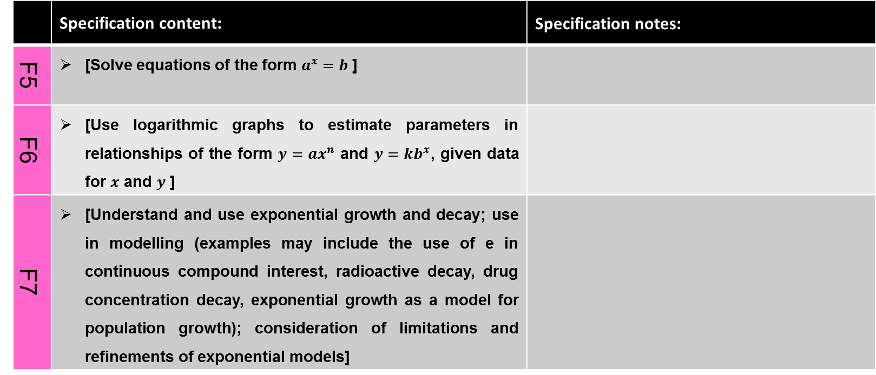
Exponentials & Logarithms (slides 3 of 3)
 | Specification content: | Specification notes:
F5 | [Solve equations of the form $a^{x}=b$]
F6 | [Use logarithmic graphs to estimate parameters in relationships of the form $y=ax^{n}$ and $y=kb^{x}$, given data for $x$and $y$ ]
F7 | [Understand and use exponential growth and decay; use in modelling (examples may include the use of ein continuous compound interest, radioactive decay, drug concentration decay, exponential growth as a model for population growth); consideration of limitations and refinements of exponential models]

Slide 28
Continued on next page
Statistical Sampling
 | Specification content: | Specification notes:
K1 | [Understand and use the terms ‘population’ and ‘sample’] [Use samples to make informal inferences about the population] [Understand and use sampling techniques, including simple random sampling and opportunity sampling] [Select or critique sampling techniques in the context of solving a statistical problem, including understanding that different samples can lead to different conclusions about the population] | See slide 2 Assumed knowledge: application of basic statistics to describe a population

Slide 29
Continued on next page
Data Presentation and Interpretation (slide 1 of 3)
 | Specification content: | Specification notes:
L1 | [Interpret diagrams for single-variable data, including understanding that area in a histogram represents frequency] [Connect to probability distributions] | See slide 2

Slide 30
Continued on next page
Data Presentation and Interpretation (slide 2 of 3)
 | Specification content: | Specification notes:
L2 | [Interpret scatter diagrams and regression lines for bivariate data, including recognition of scatter diagrams which include distinct sections of the population (calculations involving regression lines are excluded)] [Understand informal interpretation of correlation] [Understand that correlation does not imply causation] | See slide 2 Assumed knowledge: recognise correlation and know that it does not indicate causation

Slide 31
Continued on next page
Data Presentation and Interpretation (slide 3 of 3)
 | Specification content: | Specification notes:
L3 | [Interpret measures of central tendency and variation, extending to standard deviation] [Be able to calculate standard deviation, including from summary statistics] | See slide 2 Assumed knowledge: quartiles and inter-quartile range
L4 | [Recognise and interpret possible outliers in data sets and statistical diagrams] [Select or critique data presentation techniques in the context of a statistical problem] [Be able to clean data, including dealing with missing data, errors and outliers] | See slide 2

Slide 32
Continued on next page
Probability and Statistical Distributions
 | Specification content: | Specification notes:
M1 | [Understand and use mutually exclusive and independent events when calculating probabilities] [Link to discrete and continuous distributions] | See slide 2 Assumed knowledge: the 0 to 1 probability scale
N1 | [Understand and use simple, discrete probability distributions (calculation of mean and variance of discrete random variables is excluded), including the binomial distribution, as a model; calculate probabilities using the binomial distribution] | See slide 2

Slide 33
Continued on next page
Statistical Hypothesis Testing
 | Specification content: | Specification notes:
O1 | [Understand and apply the language of statistical hypothesis testing, developed through a binomial model: null hypothesis, alternative hypothesis, significance level, test statistic, 1-tail test, 2-tail test, critical value, critical region, acceptance region, p-value] | See slide 2 The use of correlation coefficients in hypothesis testing will be covered in year 13, Statistical Hypothesis Testing
O2 | [Conduct a statistical hypothesis test for the proportion in the binomial distribution and interpret the results in context] [Understand that a sample is being used to make an inference about the population and appreciate that the significance level is the probability of incorrectly rejecting the null hypothesis] | See slide 2

Slide 34
Continued on next page
Kinematics in One Dimension (slide 1 of 2)
 | Specification content: | Specification notes:
P1 | [Understand and use fundamental quantities and units in the S.I. system: length, time, mass] [Understand and use derived quantities and units: velocity, acceleration, force, weight] | Chapter 7.1 Moments be covered in year 13, Moments
Q1 | [Understand and use the language of kinematics: position; displacement; distance travelled; velocity; speed; acceleration] | Chapter 7.2

Slide 35
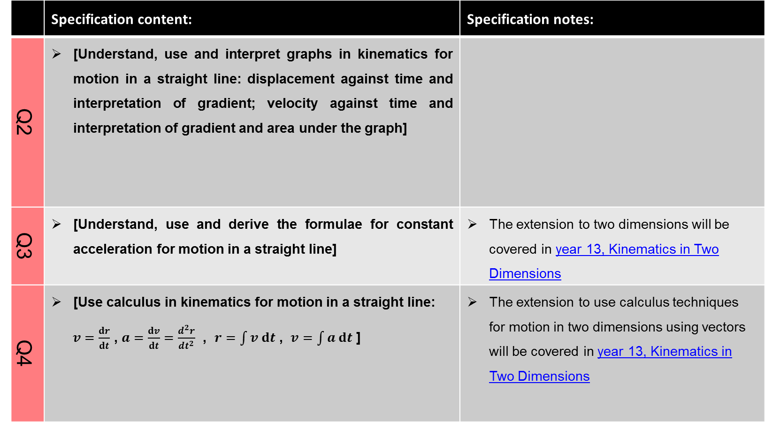
Kinematics in One Dimension (slide 2 of 2)
 | Specification content: | Specification notes:
Q2 | [Understand, use and interpret graphs in kinematics for motion in a straight line: displacement against time and interpretation of gradient; velocity against time and interpretation of gradient and area under the graph] | Chapter 7.2
Q3 | [Understand, use and derive the formulae for constant acceleration for motion in a straight line] | Chapter 7.3 The extension to two dimensions will be covered in year 13, Kinematics in Two Dimensions
Q4 |  | Chapter 7.4 The extension to use calculus techniques for motion in two dimensions using vectors will be covered in year 13, Kinematics in Two Dimensions

Slide 36
Continued on next page
Forces and Newton’s Laws (slide 1 of 3)
 | Specification content: | Specification notes:
R1 | [Understand the concept of a force; understand and use Newton’s first law] | Chapter 8.1
R2 | [Understand and use Newton’s second law for motion in a straight line (restricted to forces in two perpendicular directions or simple cases of forces given as 2-D vectors)] | Chapter 8.2 The extension to situations where forces need to be resolved in two dimensions will be covered in year 13, Equilibrium & Resolving

Slide 37
Continued on next page
Forces and Newton’s Laws (slide 2 of 3)
 | Specification content: | Specification notes:
R3 | [Understand and use weight and motion in a straight line under gravity; gravitational acceleration, g , and its value in S.I. units to varying degrees of accuracy] [(the inverse square law for gravitation is not required and g may be assumed to be constant, but students should be aware that g is not a universal constant but depends on location)] | Chapter 8.3

Slide 38
Forces and Newton’s Laws (slide 3 of 3)
 | Specification content: | Specification notes:
R4 | [Understand and use Newton’s third law; equilibrium of forces on a particle and motion in a straight line (restricted to forces in two perpendicular directions or simple cases of forces given as 2-D vectors); application to problems involving smooth pulleys and connected particles] | Chapter 8.4 Resolving forces in two dimensions and the equilibrium of a particle under coplanar forces will be covered in year 13, Equilibrium & Resolving

Slide 39
Continued on next page
Statistical Distributions
 | Specification content: | Specification notes
N2 | Understand and use the Normal distribution as a model; find probabilities using the Normal distribution Link to histograms, mean, standard deviation, points of inflection and the binomial distribution | See slide 2 Note that N2 and N3 will be covered again in year 13, Statistical Distributions
N3 | Select an appropriate probability distribution for a context, with appropriate reasoning, including recognising when the binomial or Normal model may not be appropriate | See slide 2

Slide 40
Continued on next page
Analysis of Data using Statistical Packages
 | Specification content: | Specification notes
 | See slide 2

Slide 41
Year 13

Slide 42
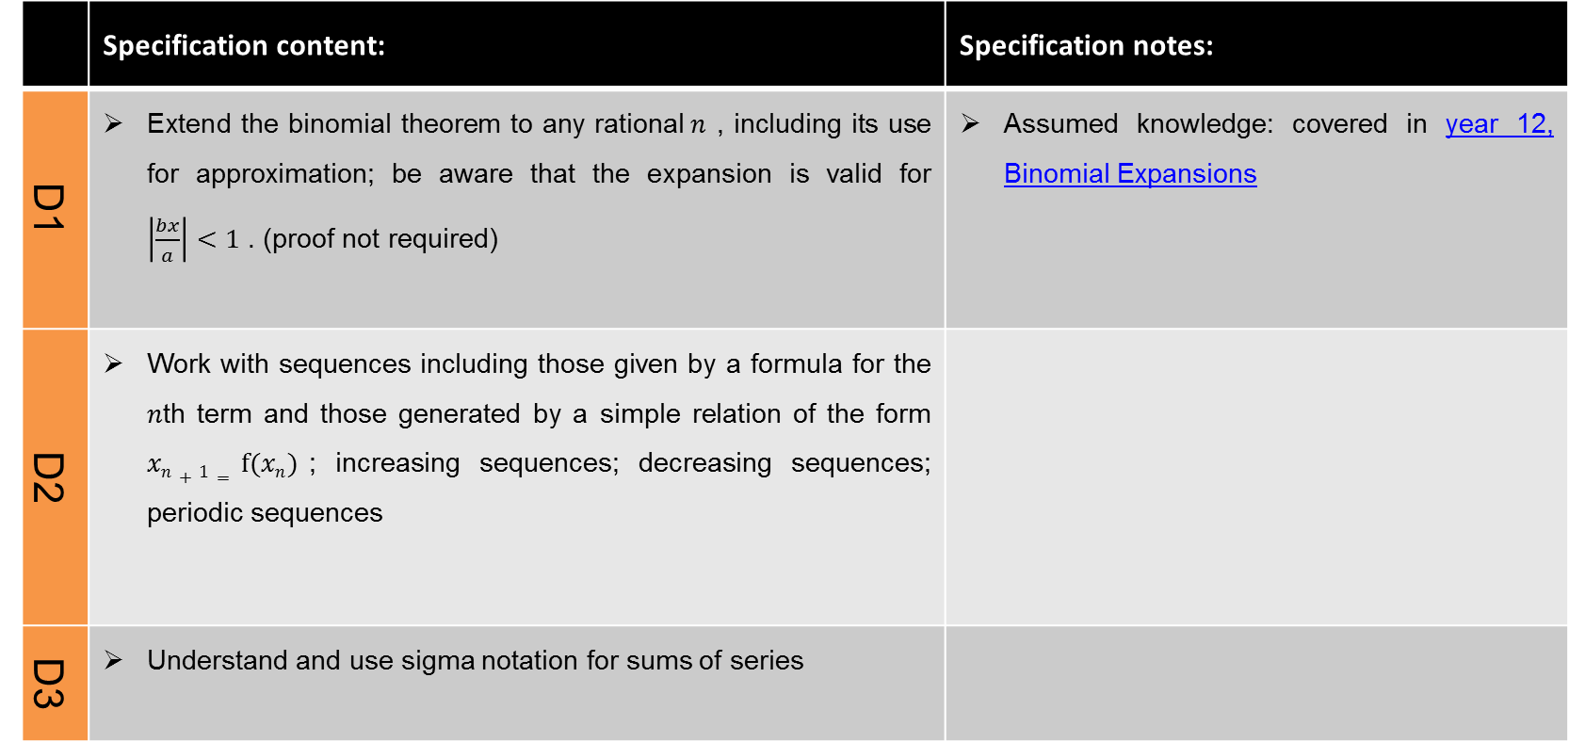
Continued on next page
Binomial Theorem, Sequences & Series (slide 1 of 2)
 | Specification content: | Specification notes:
D1 | Extend the binomial theorem to any rational$n$ , including its use for approximation; be aware that the expansion is valid for $\left|\frac{bx}{a}\right|<1$ . (proof not required) | Assumed knowledge: covered in year 12, Binomial Expansions
D2 | Work with sequences including those given by a formula for the $n$th term and those generated by a simple relation of the form $xn+1= f(xn)$; increasing sequences; decreasing sequences; periodic sequences
D3 | Understand and use sigma notation for sums of series

Slide 43
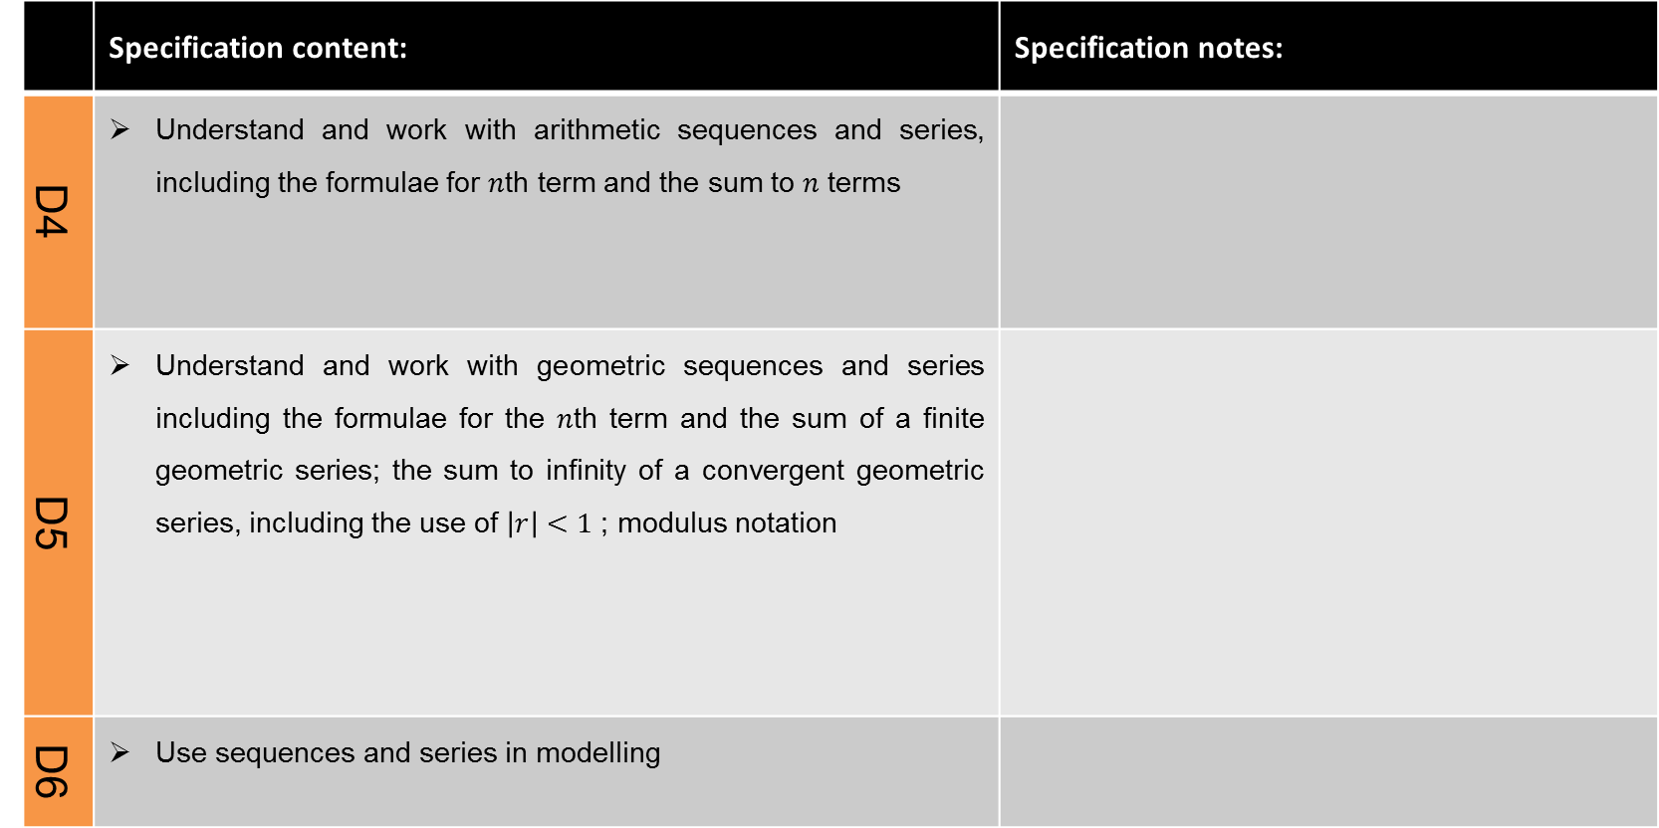
Binomial Theorem, Sequences & Series (slide 2 of 2)
 | Specification content: | Specification notes:
D4 | Understand and work with arithmetic sequences and series, including the formulae for $n$th term and the sum to $n$terms
D5 | Understand and work with geometric sequences and series including the formulae for the $n$th term and the sum of a finite geometric series; the sum to infinity of a convergent geometric series, including the use of$\left|r\right|<1$ ; modulus notation
D6 | Use sequences and series in modelling

Slide 44
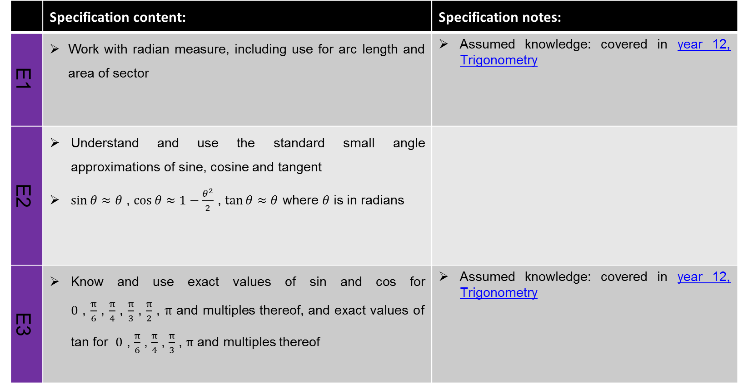
Continued on next page
Trigonometry & Circular Measure (slide 1 of 2)
 | Specification content: | Specification notes:
E1 | Work with radian measure, including use for arc length and area of sector | Assumed knowledge: covered in year 12, Trigonometry
E2 | Understand and use the standard small angle approximations of sine, cosine and tangent $\sin{θ}≈θ$ , $\cos{θ≈1−\frac{θ^{2}}{2}}$ , $\tan{θ≈θ}$ where $θ$ is in radians
E3 | Know and use exact values of sin and cos for $0$ ,$\frac{π}{6}$ , $\frac{π}{4}$ , $\frac{π}{3}$ ,$\frac{π}{2}$ , $π$ and multiples thereof, and exact values of tan for $0$ ,$\frac{π}{6}$ , $\frac{π}{4}$ , $\frac{π}{3}$ , $π$ and multiples thereof | Assumed knowledge: covered in year 12, Trigonometry

Slide 45
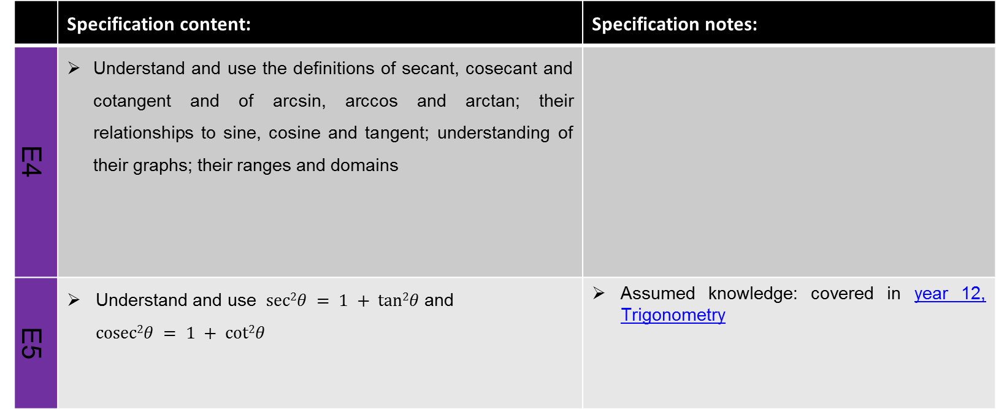
Trigonometry & Circular Measure (slide 2 of 2)
 | Specification content: | Specification notes:
E4 | Understand and use the definitions of secant, cosecant and cotangent and of arcsin, arccos and arctan; their relationships to sine, cosine and tangent; understanding of their graphs; their ranges and domains
E5 | Understand and use $sec2θ = 1 + tan2θ$and $cosec2θ = 1 + cot2θ$ | Assumed knowledge: covered in year 12, Trigonometry

Slide 46
Functions & Transformations
 | Specification content: | Specification notes:
B6 | Simplify rational expressions including by factorising and cancelling, and algebraic division (by linear expressions only) | Assumed knowledge: covered in year 12, Algebraic Manipulation, Quadratic Equations & Simultaneous Equations
B7 | The modulus of a linear function | Assumed knowledge: covered in year 12, Graphs, Linear & Quadratic Inequalities
B8 | Understand and use composite functions; inverse functions and their graphs
B9 | Combinations of transformations (translations and stretches) | Assumed knowledge: covered in year 12, Graphs, Linear & Quadratic Inequalities

Slide 47
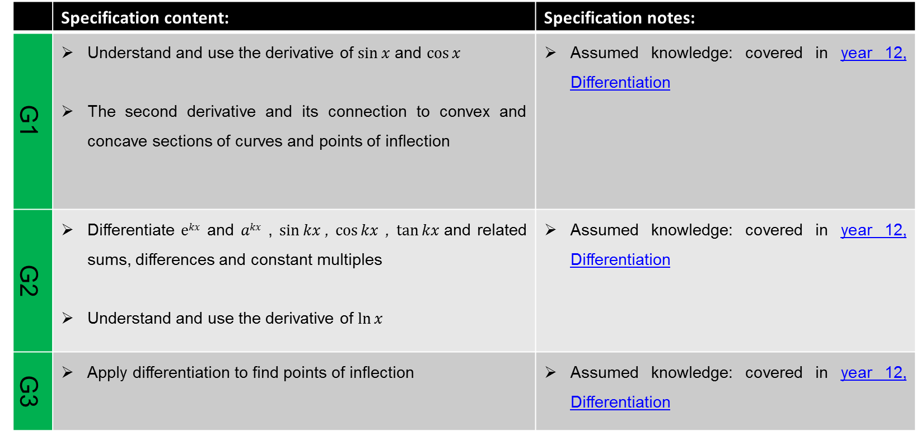
Continued on next page
Further Differentiation (slide 1 of 2)
 | Specification content: | Specification notes:
G1 | Understand and use the derivative of $sin⁡x$and $cos⁡x$ The second derivative and its connection to convex and concave sections of curves and points of inflection | Assumed knowledge: covered in year 12, Differentiation
G2 | Differentiate $ekx$and $akx$, $sin⁡kx$, $cos⁡kx$ , $tan⁡kx$and related sums, differences and constant multiples Understand and use the derivative of $ln⁡x$ | Assumed knowledge: covered in year 12, Differentiation
G3 | Apply differentiation to find points of inflection | Assumed knowledge: covered in year 12, Differentiation

Slide 48
Further Differentiation (slide 2 of 2)
 | Specification content: | Specification notes:
G4 | Differentiate using the product rule, the quotient rule and the chain rule, including problems involving connected rates of change and inverse functions | Assumed knowledge: covered in year 12, Differentiation

Slide 49
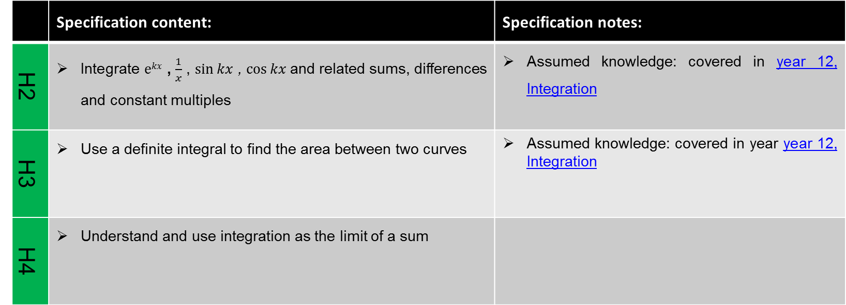
Continued on next page
Further Integration (slide 1 of 2)
 | Specification content: | Specification notes:
H2 | Integrate $ekx$, $\frac{1}{x}$ , $sin⁡kx$ , $cos⁡kx$and related sums, differences and constantmultiples | Assumed knowledge: covered in year 12, Integration
H3 | Use a definite integral to find the area between two curves | Assumed knowledge: covered in year year 12, Integration
H4 | Understand and use integration as the limit of a sum

Slide 50
Further Integration (slide 2 of 2)
 | Specification content: | Specification notes:
H5 | Carry out simple cases of integration by substitution and integration by parts; understand these methods as the inverse processes of the chain and product rules respectively (Integration by substitution includes finding a suitable substitution and is limited to cases where one substitution will lead to a function which can be integrated; integration by parts includes more than one application of the method but excludes reduction formulae)

Slide 51
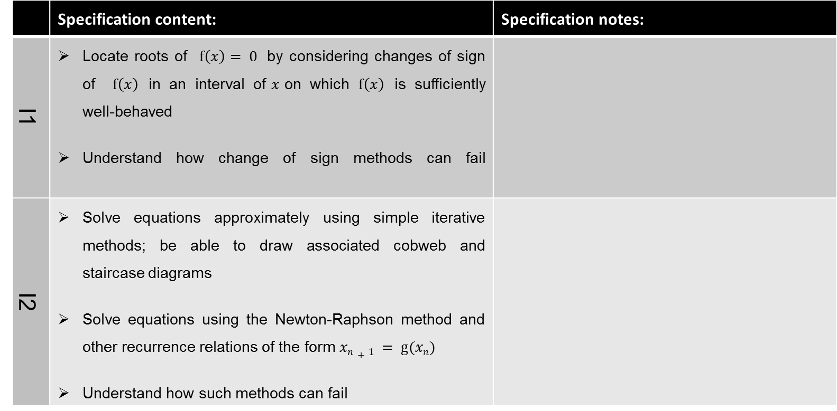
Continued on next page
Numerical Methods (slide 1 of 2)
 | Specification content: | Specification notes:
I1 | Locate roots of $f\left(x\right)= 0$ by considering changes of sign of $f\left(x\right)$ in an interval of$x$on which $f\left(x\right)$ is sufficiently well-behaved Understand how change of sign methods can fail
I2 | Solve equations approximately using simple iterative methods; be able to draw associated cobweb and staircase diagrams Solve equations using the Newton-Raphson method and other recurrence relations of the form $xn+1 = g(xn)$ Understand how such methods can fail

Slide 52
Numerical Methods (slide 2 of 2)
 | Specification content: | Specification notes:
I3 | Understand and use numerical integration of functions, including the use of the trapezium rule and estimating the approximate area under a curve and limits that it must lie between
I4 | Use numerical methods to solve problems in context

Slide 53
Parametric Equations
 | Specification content: | Specification notes:
C3 | Understand and use the parametric equations of curves and conversion between Cartesian and parametric forms
C4 | Use parametric equations in modelling in a variety of contexts
G5 | Differentiate simple functions and relations defined implicitly or parametrically, for first derivative only

Slide 54
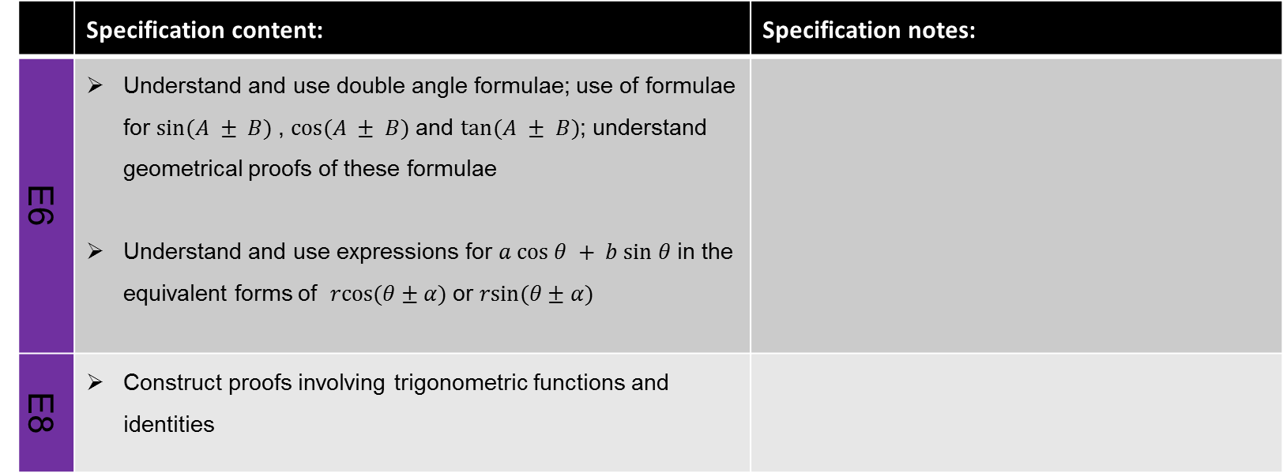
Trigonometry
 | Specification content: | Specification notes:
E6 | Understand and use double angle formulae; use of formulae for$sin⁡(A ± B)$, $cos⁡(A ± B)$and $tan⁡(A ± B)$; understand geometrical proofs of these formulae Understand and use expressions for $a cos θ + b sin θ$in the equivalent forms of $rcos(θ±α)$or $rsin(θ±α)$
E8 | Construct proofs involving trigonometric functions and identities

Slide 55
Partial Fractions & Integration
 | Specification content: | Specification notes:
B10 | Decompose rational functions into partial fractions (denominators not more complicated than squared linear terms and with no more than 3 terms, numerators constant or linear)
H6 | Integrate using partial fractions that are linear in the denominator

Slide 56
Continued on next page
Differential Equations (slide 1 of 2)
 | Specification content: | Specification notes:
B11 | Use of functions in modelling, including consideration of limitations and refinements of the models
G5 | Differentiate simple functions and relations defined implicitly, for first derivative only
G6 | Construct simple differential equations in pure mathematics and in context, (contexts may include kinematics, population growth and modelling the relationship between price and demand)

Slide 57
Differential Equations (slide 2 of 2)
 | Specification content: | Specification notes:
H7 | Evaluate the analytical solution of simple first order differential equations with separable variables, including finding particular solutions (Separation of variables may require factorisation involving a common factor)
H8 | Interpret the solution of a differential equation in the context of solving a problem, including identifying limitations of the solution; includes links to kinematics

Slide 58
Continued on next page
Kinematics in Two Dimensions (slide 1 of 2)
 | Specification content: | Specification notes:
J1 | Use vectors in three dimensions | Assumed knowledge: covered in year 12, Vectors
J5 | Use vectors to solve problems in kinematics | Assumed knowledge: covered in year 12, Vectors
E9 | Use trigonometric functions to solve problems in context, including problems involving vectors, kinematics and forces
Q3 | Understand, use and derive the formulae for constant acceleration for motion in 2 dimensions using vectors | Assumed knowledge: covered in year 12, Kinematics in One Dimension

Slide 59
Kinematics in Two Dimensions (slide 2 of 2)
 | Specification content: | Specification notes:
Q4 | Use calculus in kinematics for motion in 2 dimensions using vectors | Assumed knowledge: covered in year 12, Kinematics in One Dimension
Q5 | Model motion under gravity in a vertical plane using vectors; projectiles

Slide 60
Equilibrium and Resolving
 | Specification content: | Specification notes:
R2 | Understand and use Newton’s second law for motion in situations where forces need to be resolved (restricted to 2 dimensions) | Assumed knowledge: covered in year 12, Forces & Newton’s Laws
R4 | Resolving forces in 2 dimensions; equilibrium of a particle under coplanar forces | Assumed knowledge: covered in year 12, Forces & Newton’s Laws

Slide 61
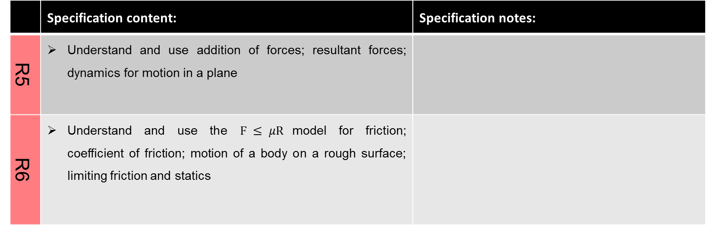
Statics and Dynamics
 | Specification content: | Specification notes:
R5 | Understand and use addition of forces; resultant forces; dynamics for motion in a plane
R6 | Understand and use the $F ≤ μR$model for friction; coefficient of friction; motion of a body on a rough surface; limiting friction and statics

Slide 62
Moments
 | Specification content: | Specification notes:
P1 | Understand and use derived quantities and units: moment | Assumed knowledge: covered in year 12, Kinematics in One Dimension
S1 | Understand and use moments in simple static contexts

Slide 63
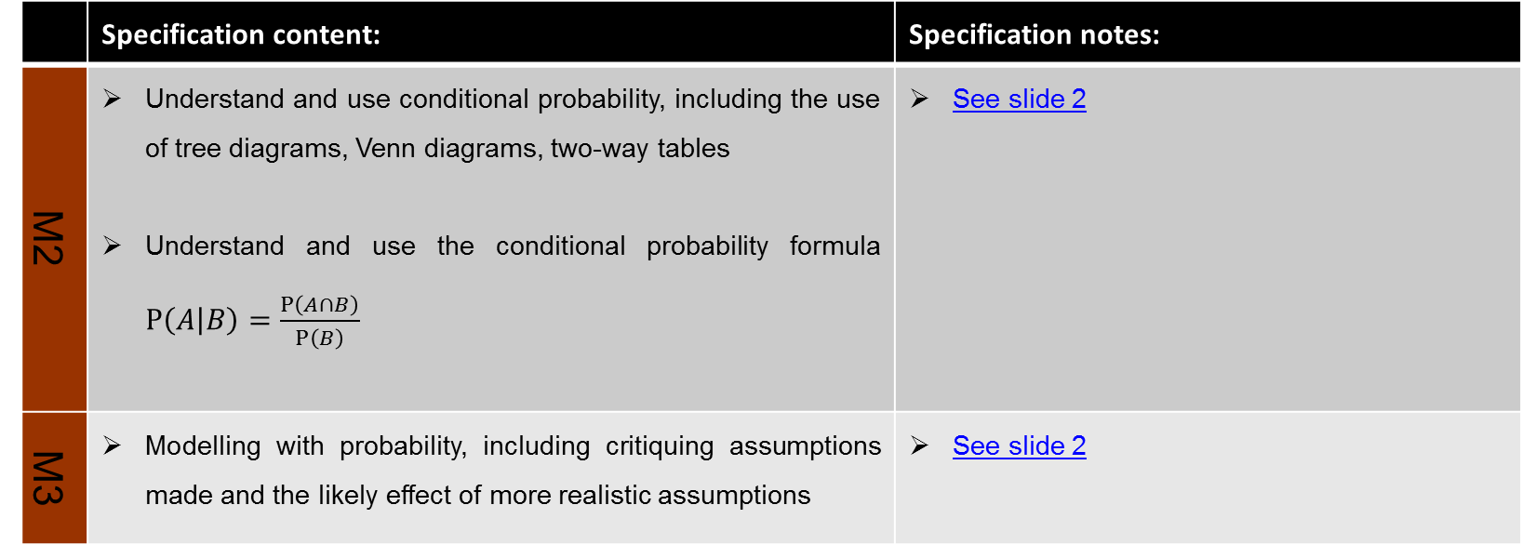
Continued on next page
Further Probability
 | Specification content: | Specification notes:
M2 | Understand and use conditional probability, including the use of tree diagrams, Venn diagrams, two-way tables Understand and use the conditional probability formula $P\left(A | B\right)=\frac{P\left(A∩B\right)}{P\left(B\right)}$ | See slide 2
M3 | Modelling with probability, including critiquing assumptions made and the likely effect of more realistic assumptions | See slide 2

Slide 64
Continued on next page
Statistical Distributions
 | Specification content: | Specification notes
N2 | Understand and use the Normal distribution as a model; find probabilities using the Normal distribution Link to histograms, mean, standard deviation, points of inflection and the binomial distribution | See slide 2
N3 | Select an appropriate probability distribution for a context, with appropriate reasoning, including recognising when the binomial or Normal model may not be appropriate

Slide 65
Continued on next page
Statistical Hypothesis Testing
 | Specification content: | Specification notes
O1 | Understand and apply correlation coefficients as measures of how close data points lie to a straight line and be able to interpret a given correlation coefficient using a given p-value or critical value (calculation of correlation coefficients is excluded) | See slide 2 Assumed knowledge: covered in year 12, Statistical Hypothesis Testing
O3 | Conduct a statistical hypothesis test for the mean of a Normal distribution with known, given or assumed variance and interpret the results in context | See slide 2

